Slide 1

Looking at a real-world app Thomas Künneth
https://unsplash.com/photos/VYOrErmJes4

Slide 2
Questions 🤔

Slide 3
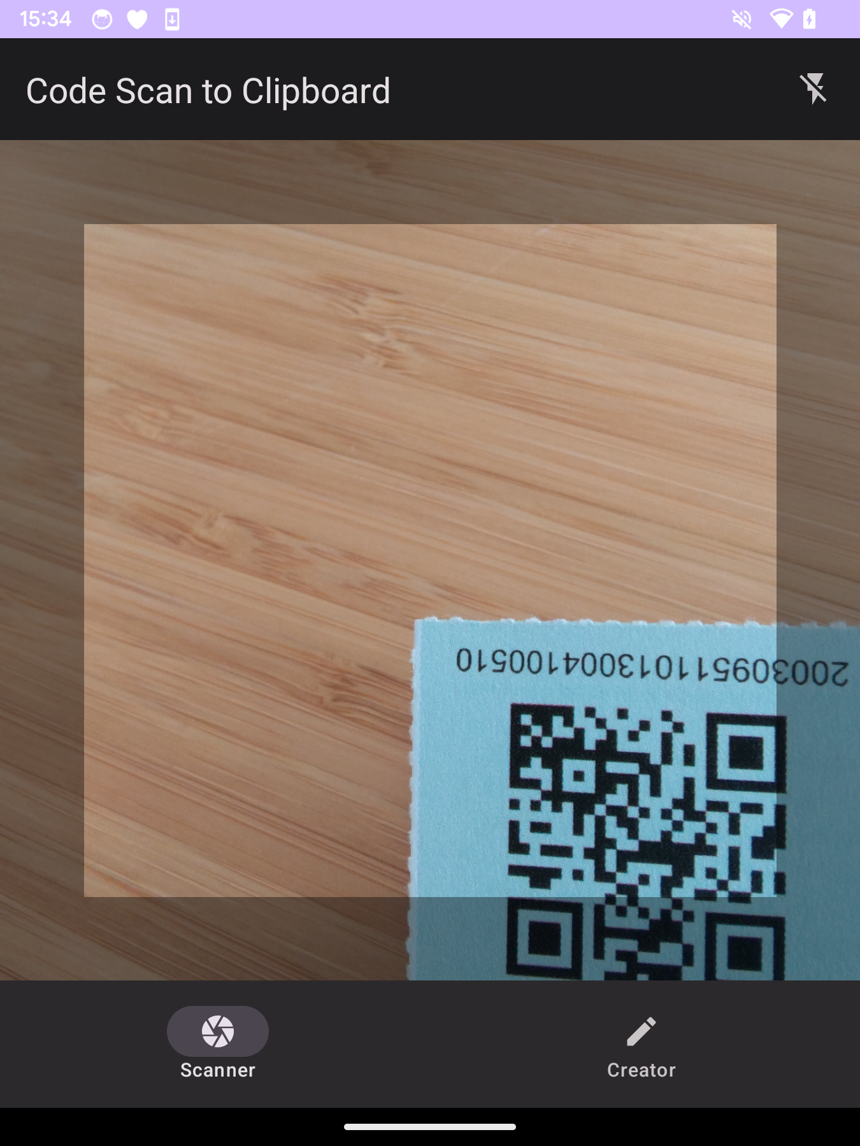
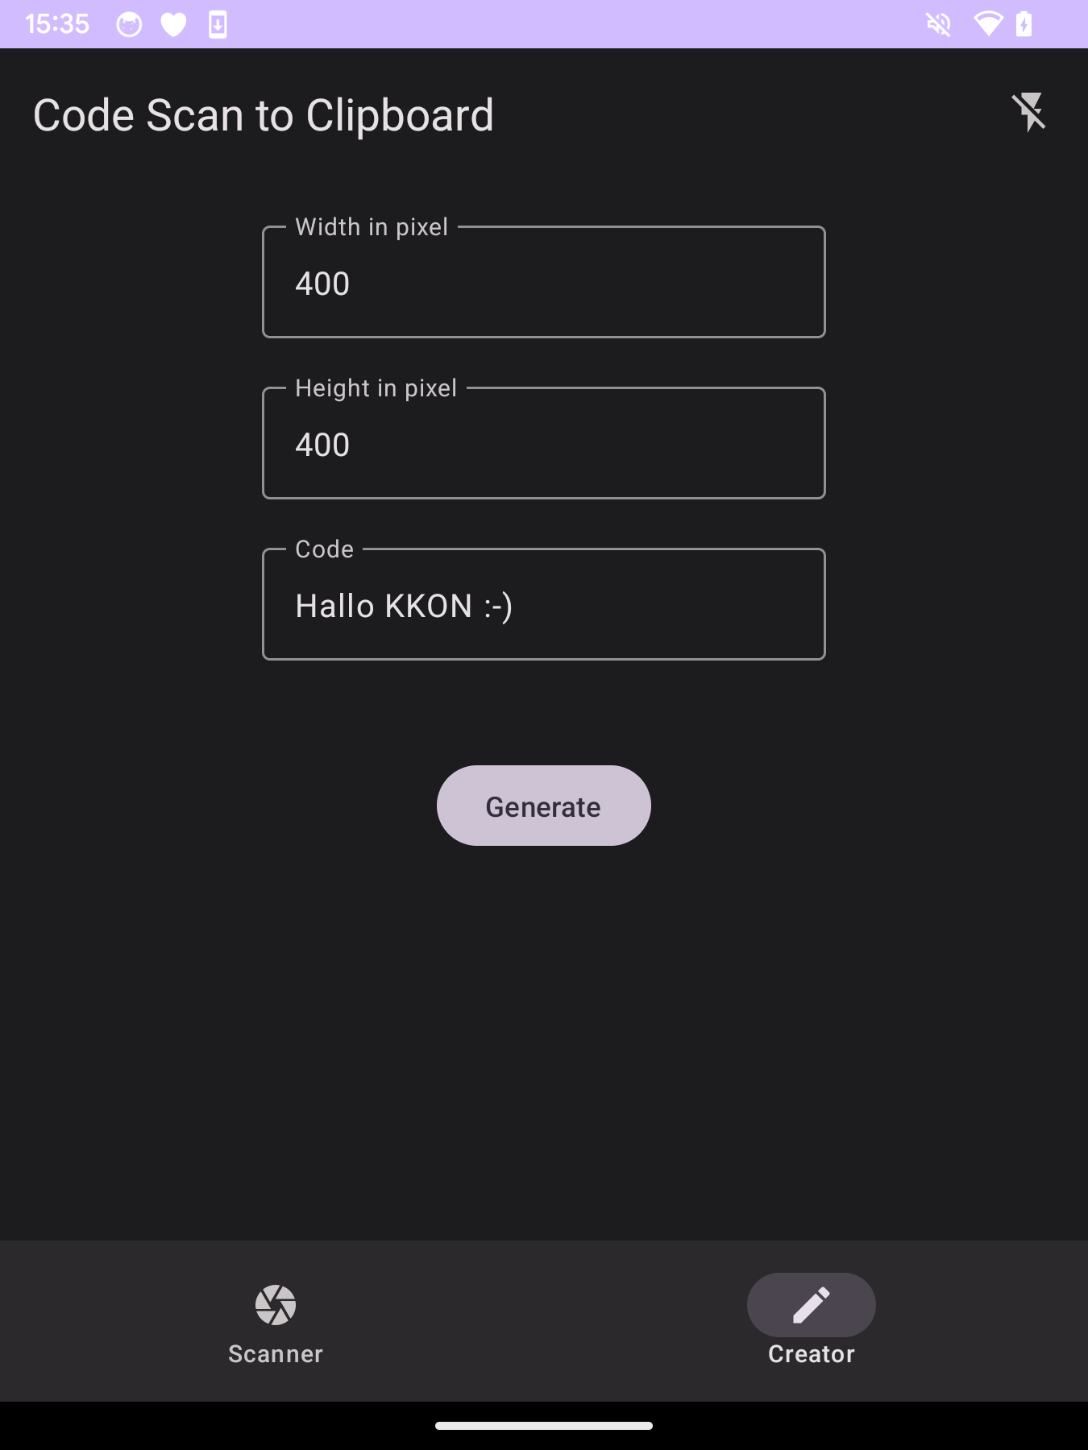
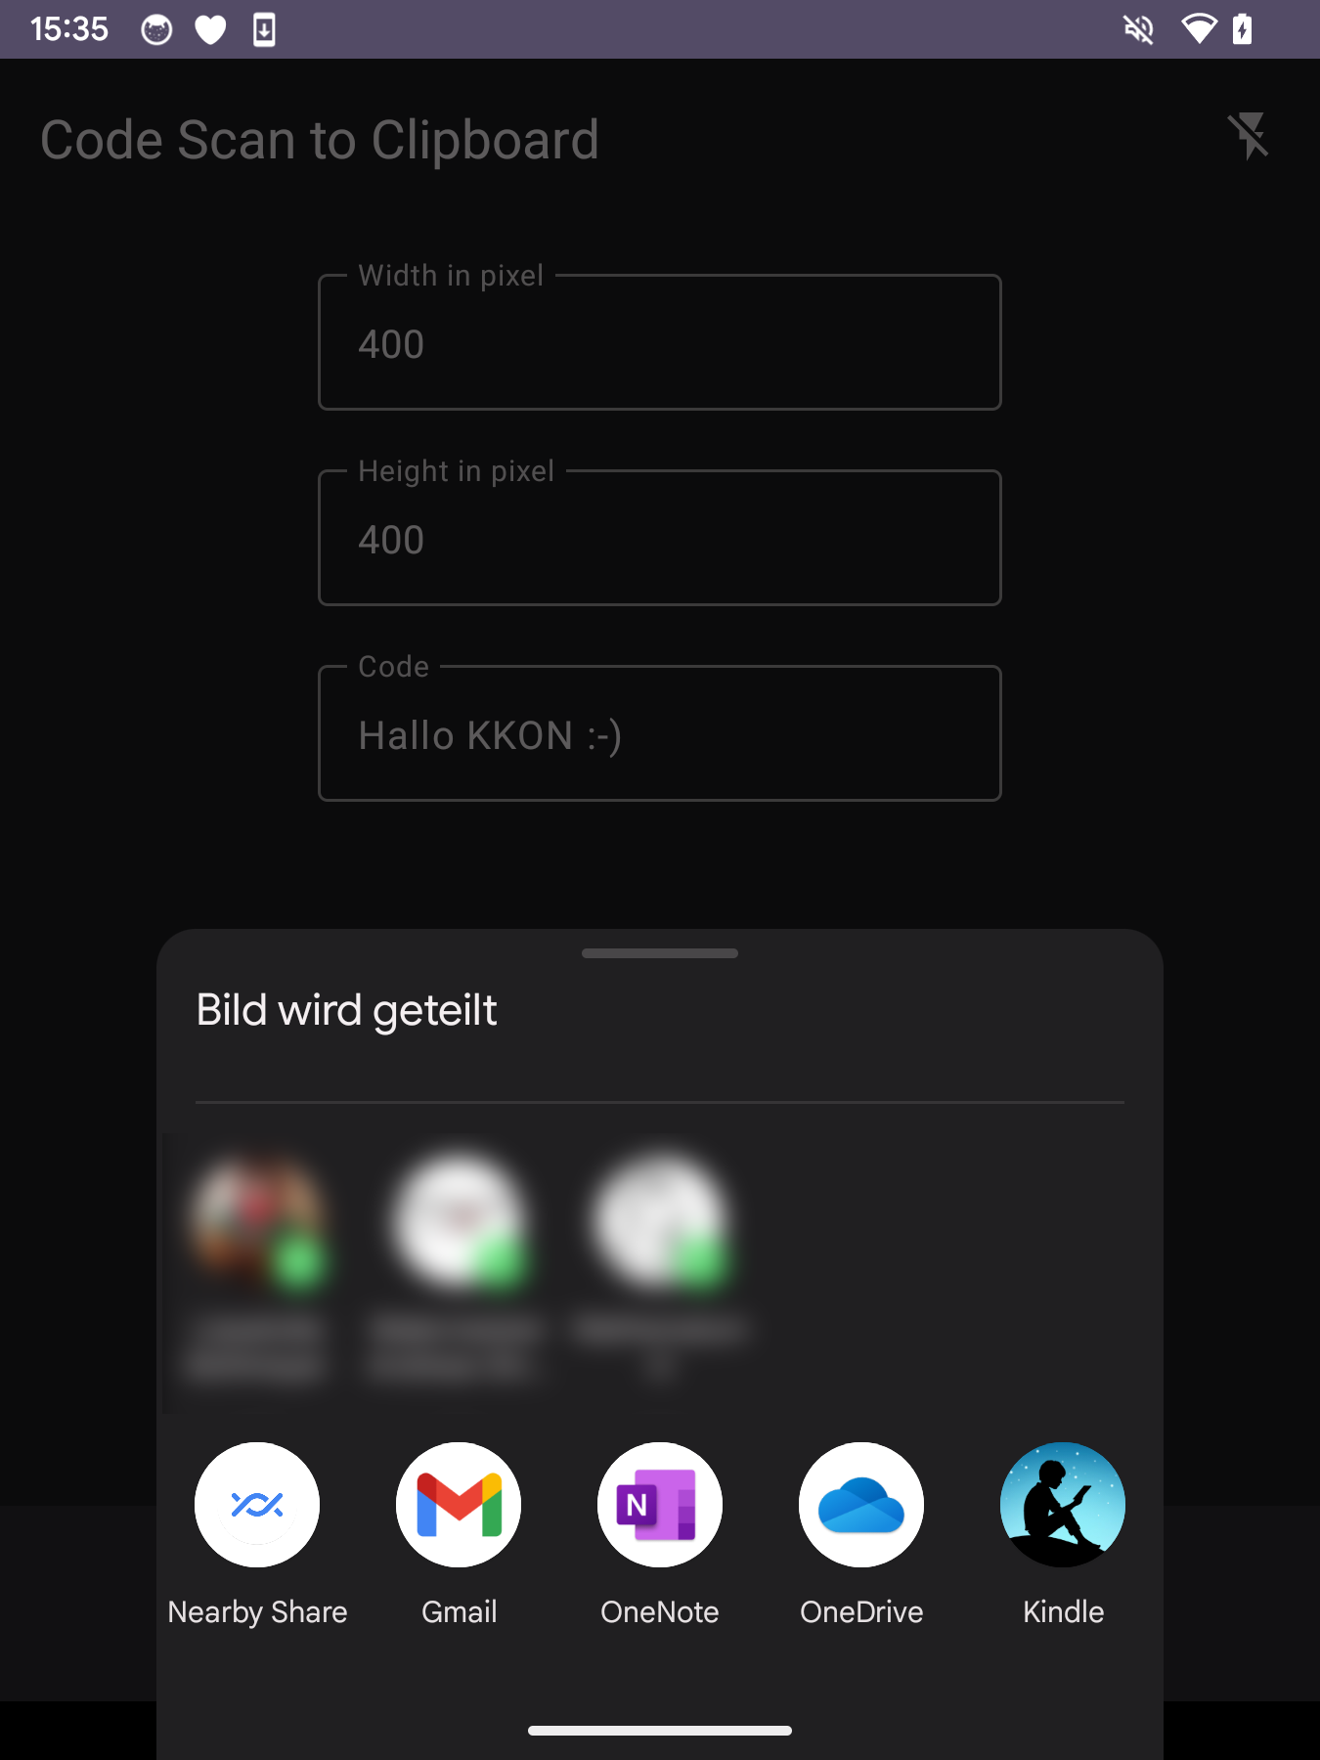
https://github.com/tkuenneth/CodeScanToClipboard

Slide 4

Short break… 😍

